Slide 1
Week 5
Advanced Image Capture
File Input/Output
Image Processing
Notes:
Things to improve:
Confusion about copying into/out of OS-provided buffers

Slide 2
Thread Contention
Communicating from one thread to another is hard
Non-deterministic timing makes read/writes difficult
Ex: One thread might be replacing a buffer that another thread is using
Enter the lock() statement
This allows us to “lock” a section of code, based on a key
No other thread can enter a locked section of code with that same key
This allows us to modify data without fear
Other threads will just sit and wait until we’re done with our locked section

Slide 3
Locks Demo

Slide 4
Overview
Today is when we tackle Images in earnest
We’re going to learn how to get image streams in native code
That is, video
Just like with audio, APIs get more complex the more data you handle
Video is probably the most bits/second we’ll ever deal with
1920 pixels * 1080 pixels * 4 bytes * 30 fps = 237.3 MB/sec
Although not as complex as WASAPI, still complex
We’re using older APIs because the newer ones are too complicated
This means we’ll use the “Windows Phone 8.1 (Silverlight)” template
Our phone doesn’t have the guts to do too much with a 1080p stream
We’ll be limiting ourselves to 720p, more than enough for most things

Slide 5
Image Streams
We begin with an overview of important concepts
Rather than bore you all with loads of implementation details
We’ll cover the concepts, then use wrapper classes to do the boring stuff
If you want to learn, check out the class: AudioVideoCaptureDevice
Available in both C# and C++
Sets full-frame capture resolution
Can do simultaneous audio and video recording
Note that you cannot use WASAPI and AVCD audio recording
You must use one or the other
We’ll then move on to more interesting topics!
Video stream manipulation is really fun!

Slide 6
Image Streams
We will structure our wrapper classes as follows:
Camera
libvideo Wrapper
C# Code
XAML
C++ Processing
Texture
Renderer

Slide 7
Image Streams
Images are represented as arrays of 32-bit pixels
This Format is known as “ARGB”
Alpha, Red, Green, Blue, 8 bits each
We address them as unsigned integer arrays
You will find many C# APIs passing around int[] values as Pixel Data
Logically laid out as a 2-dimensional array of width by height
In both C# and C++, allocated as a “flat” 1-d array
We must manually treat it like a 2d array
To address a point (x,y) in 2d space, we use: data[y*width + x]
When manually assigning pixel values, hexadecimal is useful:
data[y*width + x] = 0xffffffff;
Pixel Layout

Slide 8
libvideo Wrapper
Deals with the boring, low-level Camera APIs
Opens a camera at a specific Capture and Preview resolution
NOTE: in practice, we will not be capturing, only previewing, due to the 1080p capturing bug, as we can preview at 720p
Sets up an internal processing thread to manage a buffer of frames
Exposes an OnFrameReady event that is fired every time a frame is received
This event is triggered on that internal processing thread
If your code is too slow, drops frames, keeping no more than 3 queued
Remember that this is happening on a processing thread
Dispatchers and locks ahoy

Slide 9
A note on events
libvideo requires high memory bandwidth
Constructing a Platform::Array<unsigned int> for every frame is slow
Slow for 640x480, impossible for 1280x720
Much better to simply keep the data in its native unsigned int *
But we can’t expose events like this, those are native types!
Solution: dirty pointer trick
This is where we abuse our knowledge of how computers actually work
Save the address of the native array to an uintptr_t, pass that around
In your events, all pointers become uintptr_t values
In event recipients, typecast back from uintptr_t to native array
The uintptr_t type is defined as unsigned int on our architecture
Get it by #including stdlib.h

Slide 10
TextureGraph
A class similar in spirit to LineGraph
Instead of graphing a line, graphs a texture
Takes an image, renders it as a textured quad
Uses DirectX, and is thus as fast as I could make it
Fast enough for 30fps playback, easily
Raises interesting possibilities for image processing
Any array you can generate, you can now view
Uses the same pixel format as the camera
For reference, that’s called DXGI_FORMAT_B8G8R8A8_UNORM
Instead of setArray(), now has setTexture()

Slide 11
Connecting it together
We can use C#
Instantiate a libvideo.Camera and a TextureGraph.TextureGraphInterop
Connect the Camera’s OnFrameReady event to setTexture()
This does work!
However, more often than not, we want to intercept the data
Process it, modify it, etc…
So we’ll use C++
Interestingly enough, the procedure for connecting stuff up is still easy!
We’ll create a class called ImageProcessing, and define processFrame()
This will be the subscriber to Camera.OnFrameReady
It will then process the data, and finally pass it off to setTexture()

Slide 12
Live Demo

Slide 13
Image Processing
This can quickly get very fun
We can play around with the raw r/g/b values and apply color filters
We can threshold the image to try to detect objects that stand out
We can start incorporating the values of neighboring pixels
This is the basis of a wide range of segmentation algorithms
We can take Fourier Transforms!
Yes, fftw has a 2d FFT interface, I haven’t wrapped it yet though
We can perform convolution to filter our image
For those of you familiar with them (e.g. video game programmers) you can even use pixel shaders on the video stream to harness GPU power

Slide 14
Image Processing
All this fun comes at a price, however
As stated before, we are crunching through a LOT of memory
Even at the “low” resolution of 800x448, this is 41MB/sec
We need to be as efficient as possible
The difference between “Debug” and “Release” is visible here
Also yields an interesting case study for cache locality
If we access an array randomly instead of in order, it has an effect!
For some algorithms, there’s no way around it: it’s just too much data
Either need to downsample your image, (shrink the problem)
Need to run, screaming, to the cloud (increaseyour power)

Slide 15
Profiling
Profiling is the first line of defense against slow code
It allows us to find out which functions take the most time
It works on C# and C++ code!
It can run on the emulator or the device, but the device is recommended
It’s easy to run, you launch it inside of VS
It runs your program, and pauses it thousands of times per second
It counts how many times it’s within each function when it pauses
At the end of the run, is able to give you statistics:
80% of the time I paused, I was inside of foo()
I only called bar() 100 times in that whole run

Slide 16
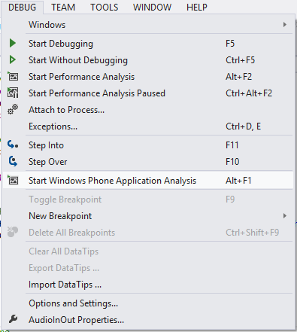
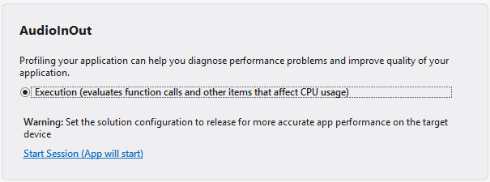
Profiling
To profile your project:
DEBUG->”Start Windows Phone Application Analysis”
Also available via ALT+F1
Launches the profiler interface
Runs your application normally
Collects function call statistics

Slide 17
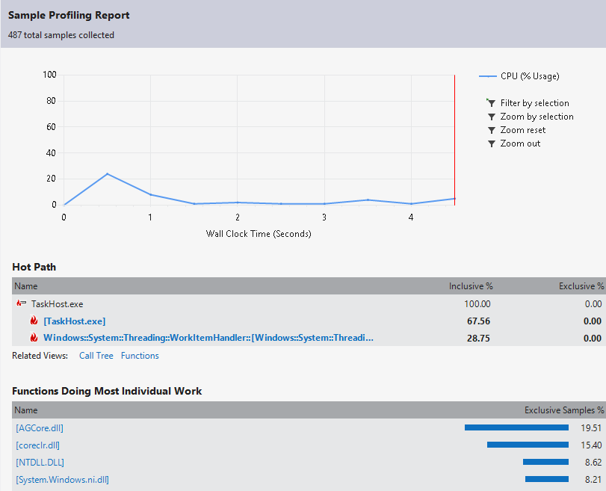
Profiling

Slide 18
Live Profiler Demo

Slide 19
Storage
We can bundle static data (Local Resources)
Using this we can provide our app with files it can read in
Done via Application.GetResourceStream(…)
We can also store data out in read/write areas
We can write out data collected, debug logs, etc….
Done via the Windows.Storage namespace
Applications generally can’t access each other
They’re “sandboxed”; we have our data, they have theirs

Slide 20
Storage
We first get a handle to our local application folder
StorageFolder folder = ApplicationData.Current.LocalFolder;
We then can get/create files/folders in that folder
StorageFile file = await folder.CreateFileAsync(filename);
StorageFile file = await folder.GetFileAsync(filename);
We can construct DataReader/DataWriters
Or, we could use the incredibly convenient FileIO class
await FileIO.WriteTextAsync(file, contents);
string contents = await FileIO.ReadTextAsync(file);

Slide 21
Storage
WP Power Tools is our way to transfer back to the PC
Microsoft has a tool called the “Isolated Storage Explorer”
It’s command-line, and terrible
We can save data, and transfer it to the desktop!
Note that a more “Mobile” paradigm would be to stream it via network
Or even Bluetooth!
That’s way too much work when all you want is to save a .csv though
This way, we can write things out, and then access them later

Slide 22
Local Resources
We can bundle data with our .xap
We can then read from it as if it were a file
Very useful for including static data, pictures, etc...
To do so requires very few steps:
Add the desired files to your project, and set “Build Action” as “Content”
For an example, examine Assets/ApplicationIcon.png
Then simply construct a URI pointing to it, and get a StreamResourceInfo:
Uri uri = new Uri("Assets\\ApplicationIcon.png", UriKind.Relative);
StreamResourceInfo sri = Application.GetResourceStream(uri);
You can use this StreamResourceInfo to initialize BitmapImages:
BitmapImage bi = new BitmapImage();
bi.SetSource(sri.Stream);
Which you can then use with Image XAML elements:
imOut.Source = bi;

Slide 23
Storage Demo

Slide 24
A note on Bitmaps
There are two different Bitmap objects:
BitmapImage
WriteableBitmap
There are a few important differences:
BitmapImage can be created empty, then loaded from a Stream
WriteableBitmap must be initialized with a size or source
But we can get/set pixel data from it!
If you’re loading images, then want the pixel data:
BitmapImage bi = new BitmapImage();
bi.SetSource(sri.Stream);
WriteableBitmap wb = new WriteableBitmap(bi);
// Image data available as an int[] in wb.Pixels

Slide 25
Homework 5
You will, (of course) set up an application to do real time image stream capture and processing
I will provide libraries such as libvideo and TextureGraph
As with most coding projects, hooking things up right can be half the battle
Once we’re done with that though, we get on to the good stuff!
This homework will be creative problem-solving
To get you all loosened up and ready to tackle your final projects

Slide 26
Homework 5
Live image manipulation
Implement a real time image processing app to track a simple marker
“Simple Marker”: a red rectangle
“Track”: find the location of the rectangle in a frame of video
This is meant to be a creative, fun exercise
I can think of 3-4 different ways of doing this at least
Each solution has its advantages/disadvantages
Speed, rotational invariance, scale invariance, etc…
Try something simple, if it doesn’t work, try something else
Once you have the position of the marker, copy over an image
Easiest to just load in an image as discussed earlier

Slide 27
Where to go from here
We’re at the end of the planned course material
We’ve got a few lectures left!
Lectures will from now on be a little shorter, consider them mini-lectures
What we cover is up to what you all want to learn
I have a list of “bonus topics” you can vote on
They will almost all feature

Slide 28
Example Bonus Topics
Machine Learning
Learning of data sets and classification of data
Network Communication
Bare TCP/IP communication, HTTP requests to web servers and services
Cloud-based Speech Recognition
More advanced networking patterns for multiple devices, etc…
Arduino
File storage (on the SD card)
Sensor examples
Signal Processing
Face Detection in images
Linear Predictive Coding
_______________?

